Slide 1
Process Walk-through

Slide 2
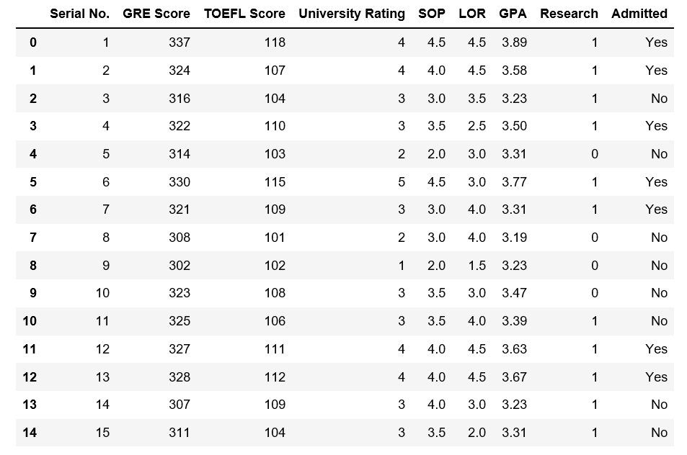

Slide 5
Exploratory Data Analysis

Slide 6
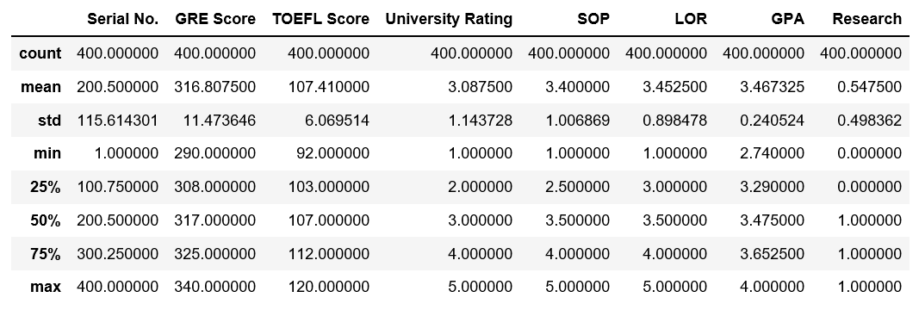
Explore Numerically

Slide 7
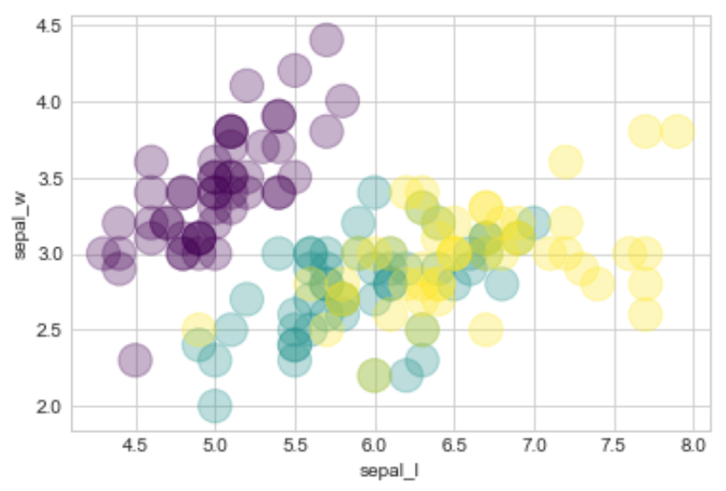
Explore Visually

Slide 8
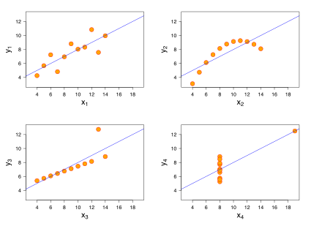
Anscombe's quartet

Slide 9
Clean the Data

Slide 10
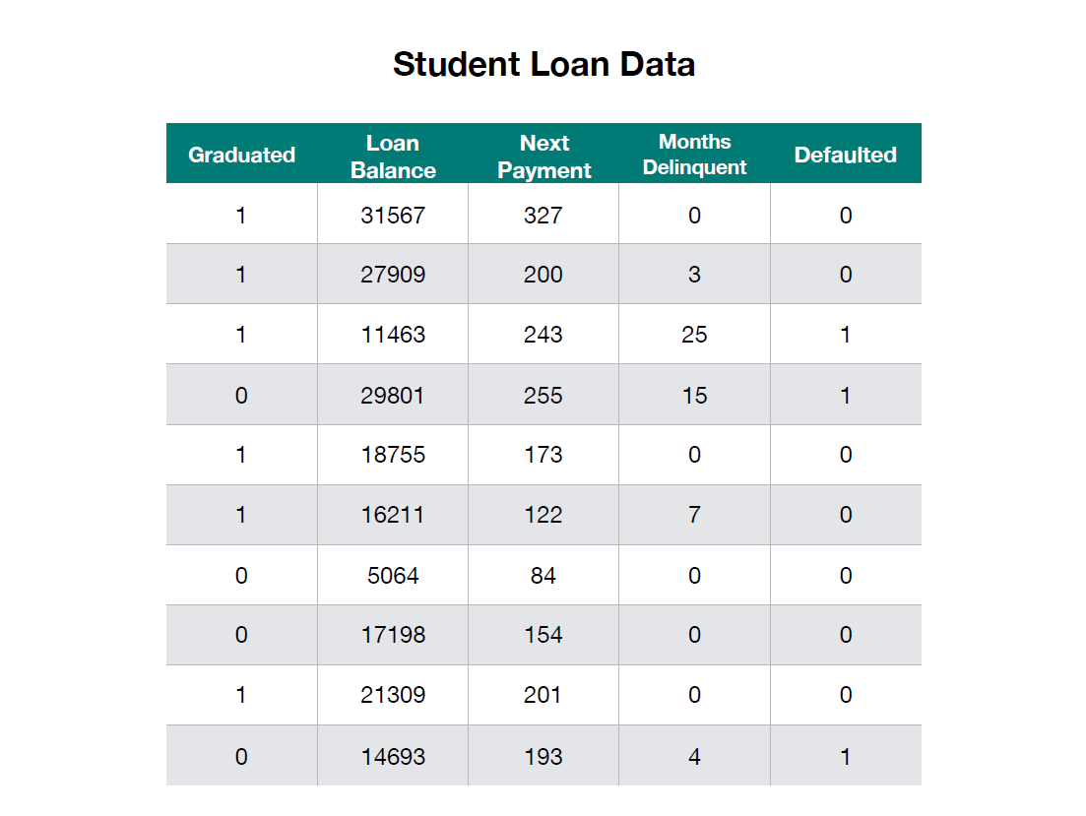
Dataset

Slide 11
Data Transformation

Slide 12
Categorical to Binary Encoding

Slide 13
Categorical to Binary Encoding
Gender
Female
Male
Female
Female
Male
Male
Female
Gender
1
0
1
1
0
0
1

Slide 14
One-hot Encoding

Slide 15
One-hot Encoding
Race
Asian
Black
White
Pacific Islander
American Indian
White
Black
American Indian | Asian | Black | Pacific Islander | White
0 | 1 | 0 | 0 | 0
0 | 0 | 1 | 0 | 0
0 | 0 | 0 | 0 | 1
0 | 0 | 0 | 1 | 0
1 | 0 | 0 | 0 | 0
0 | 0 | 0 | 0 | 1
0 | 0 | 1 | 0 | 0

Slide 16
Put the features into X
Put the target into y

Slide 17
Dataset

Slide 18
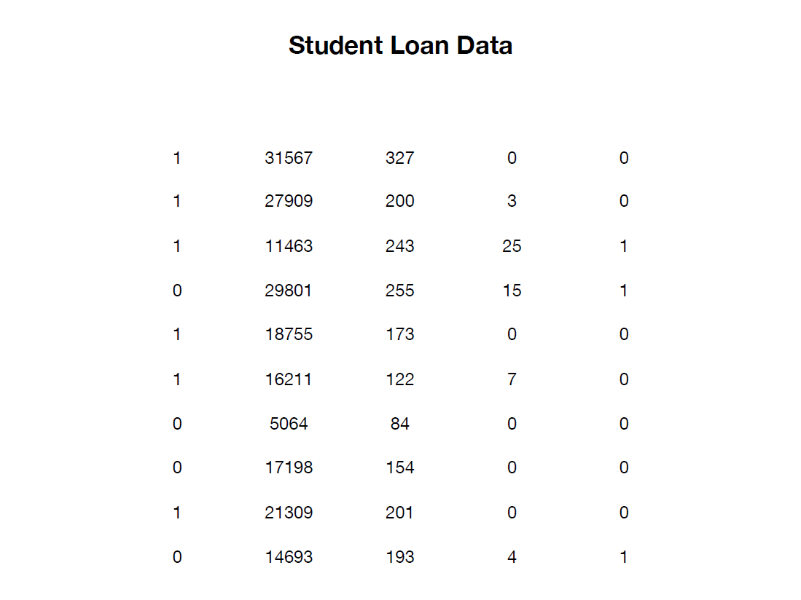
Dataset

Slide 19
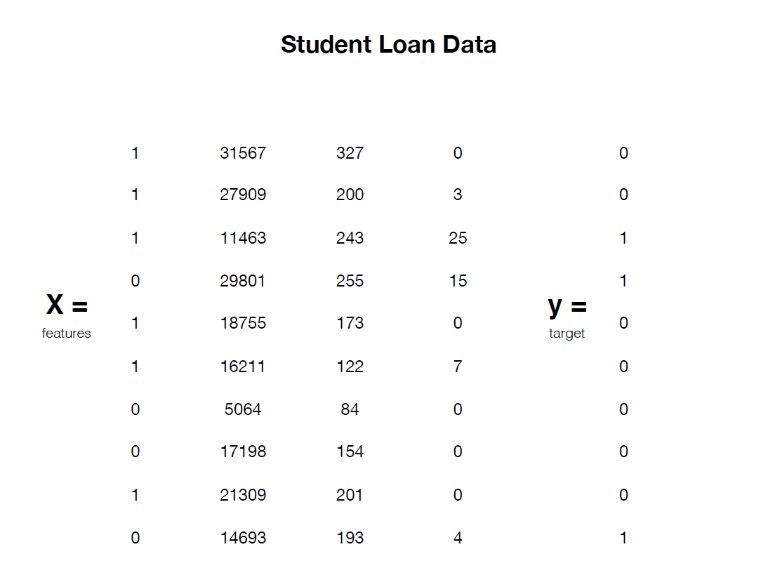
Dataset

Slide 20

Training a Model
Data Set

Slide 21
Split the Data
Training Data
Test Data

Slide 22
Split the Data
Training Data
Test Data
X_train, y_train X_test, y_test

Slide 23
Scaling

Slide 24
Normalizing
(Min-Max scaling)
Standardizing
(z-score)
x – min(X)
max(X) - min(X)
x – mean(X)
std(X)
z =

Slide 25
Normalizing
(Min-Max scaling)
Standardizing
(Z-score)
x – min(X)
max(X) - min(X)
x – mean(X)
std(X)
z =
Values between:
0 and 1

Slide 26
Normalizing
(Min-Max scaling)
Standardizing
(Z-score)
x – min(X)
max(X) - min(X)
x – mean(X)
std(X)
z =
Values between:
0 and 1
Values primarily between:
-3 and 3

Slide 27
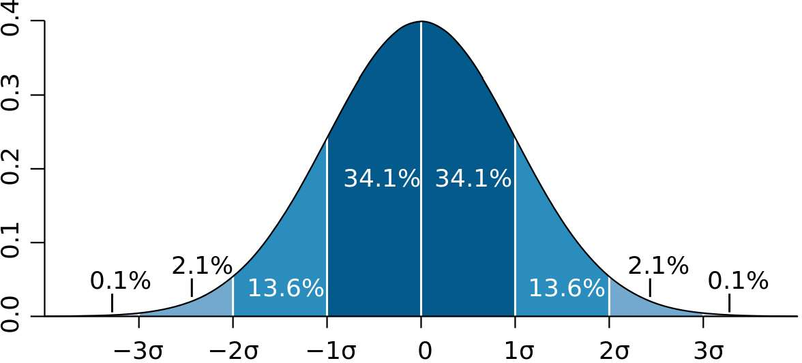
Standardize the Data

Slide 28
Model the Data

Slide 29
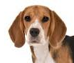
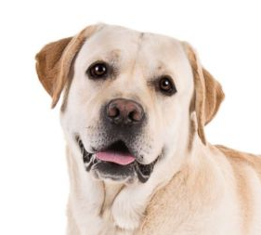
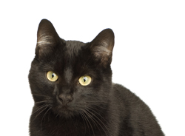

Machine Learning
Input:[ , , , ]
Relationship:
Output: [“cat”, “dog”, “dog”, “cat]

Slide 30

Common ML Algorithms
Linear Regression
Logistic Regression
Support Vector Machine
Decision Tree
K-Nearest Neighbor
=

Slide 31
Machine Learning
Input:[ , , , ]
Relationship:
Output: [“cat”, “dog”, “dog”, “cat]

Slide 32

DATA
ALGORITHM
MODEL

Slide 33

DATA
ALGORITHM
MODEL
NEW DATA
MODEL
PREDICTIONS

Slide 34
Scikit-learn

Slide 35
Scikit-learn
Model.fit(X_train,y_train)
Model.predict(X_test)
Model.score(X_test,y_test)

Slide 36
Model.fit(X_train,y_train)
TRAIN DATA
ALGORITHM
MODEL

Slide 37
Model. predict(X_test)
Prediction
0
1
0
0
1
0
TEST DATA
MODEL

Slide 38
Model. score(X_test)
Prediction | Label
0 | 1
1 | 1
0 | 0
0 | 1
1 | 0
0 | 0
Prediction
0
1
0
0
1
0
TEST DATA
MODEL

Slide 39
Train

Slide 40
Train
Test

Slide 41
Train
Test
Deploy

